Slide 1
Literature Review: The Key to the Door of Research
Jian Zhen Ou, PhD,
Australian Research Council DECRA Fellow
Senior Research Fellow
School of Engineering
RMIT University
Jianzhen.ou@rmit.edu.au

Slide 2
Lecture structure
Why literature review?
What is literature review?
The process of literature review
Tools for literature review
Example 1 Demonstration
- critical discussion
Example 2 Demonstration
Suggested structure
Conclusion

Slide 3

Why literature review ?
Attain a good knowledge of the field of enquiry
Position your work and research
Identify research opportunities
Find solutions for problem
Ref: otecportfoliomei.weebly.com

Slide 4

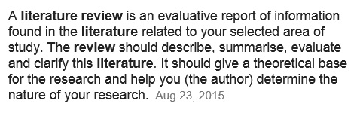
What is literature review ?
Common misunderstandings and mistakes:
A simple annotated bibliography
A combination list of unrelated literature
Lack of critical thinking or justification
Ref: studyinuk.universiablogs.net
Ref: libguides.library.cqu.edu.au

Slide 5
Common literature review process
1. Define the topic and scope
2. Search and choose for relevant literature
3. Analysis and interpret the literature
4. Summarize the findings and write the literature review

Slide 6
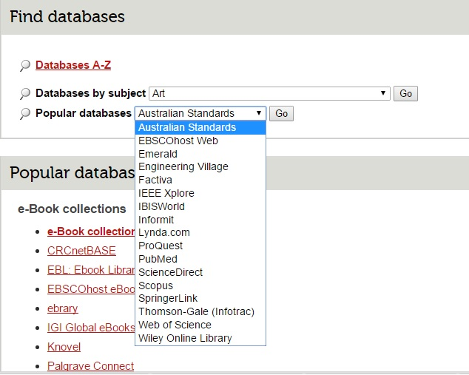
Useful tools for literature review
Database
Web of Science
Scopus
IEEE Xplore
Referencing tool
Endnote
Help?
RMIT Library

Slide 7

Example 1:
Background:
In 2011, I was invited as a co-author for reviewing the current state-of-the-art research on a nanostructured material called “tungsten oxide”.
Time from preparation to submission: 3 months

Slide 8
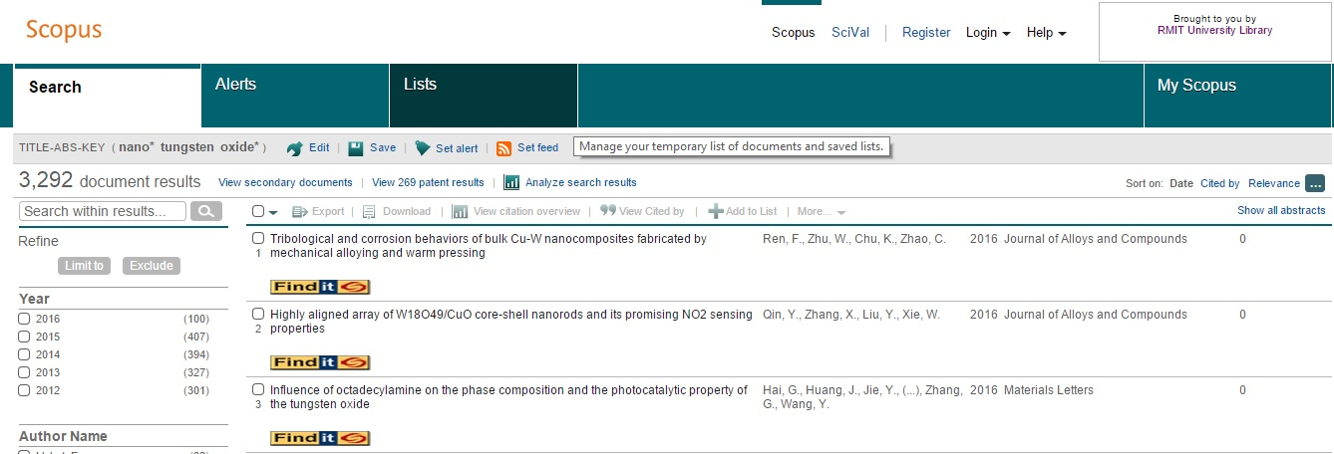
Example 1 (topic and scope definition):
Keywords:
Tungsten oxide (type in “tungsten oxide*”)
Nanostructure (type in “nano*”)
Returned at 3292 search results!!

Slide 9
Example 1 (review structure):
Properties
Crystal structure
Electronic properties (electronic band structure, conductivity etc.)
Optical properties (emissions, absorption etc.)
Other (magnetic, mechanical etc.)
Synthesis
Vapor phase (physical vapor, chemical vapor etc.)
Liquid phase (hydrothermal, electroplating etc.)
Application
Electronic devices
Optical devices
Electro-optical devices
Optoelectronic devices

Slide 10
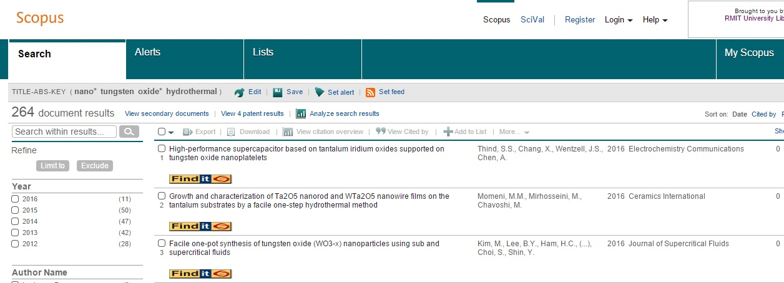
Example 1 (part search):
For hydrothermal synthesis of nanostructured tungsten oxides
Type in “ nano*, tungsten oxide*, hydrothermal”
Significantly narrow down the number of literature
Goal? I will look at the synthesis parameters and their influence on the materials’ crystal structures and morphologies

Slide 11
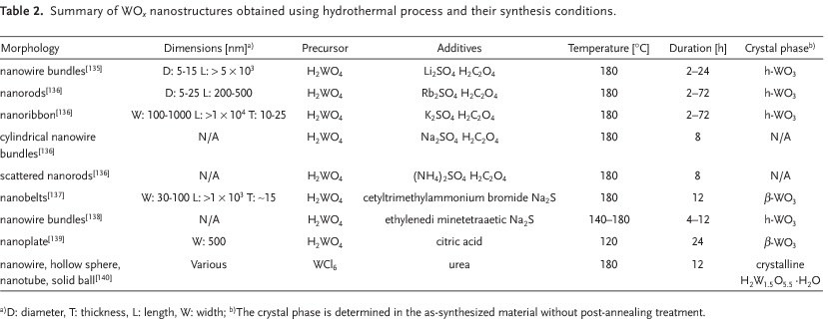
Example 1 (part search):
I used a table to summarize the parameters I was looking for
I filtered out the literature if similar parameters are presented
A short description on the table was also presented

Slide 12
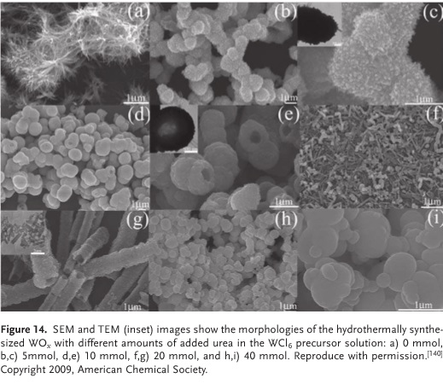
Example 1 (part search):
I also used a figure for better illustration. It is more attractive to the readers
Keep in mind that you need figure reproduction permission.

Slide 13
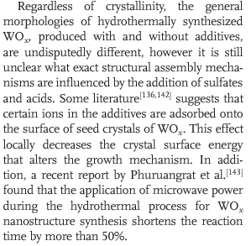
Example 1 (critical discussion):

Slide 14
Example 1 (critical discussion):
Critical discussion is the soul of the literature review. Examples include:
Advantages and disadvantages compared with other current counterparts
This method is excellent in terms of …. However……
Current unknowns and their implications
This method can be…. paving the way for developing high performance commercial system.
Suggestions on future research direction, improvements etc.
This method can be further improved by…. as suggested in the literature …..

Slide 15
Example 1 (critical discussion):
Through the literature review process, you may find new pieces of knowledge that is outside the structure you have defined earlier.
In this case, revision of the structure is needed to readily reflect the state-of-the-art knowledge framework.

Slide 16

How about you know nothing about the field?

Slide 17
A New Diagnostic Technology
Human Gas Sensing Capsule
From 2013, I am a co-leader of the “Human Gas Sensing Capsule” developing team.

Slide 18
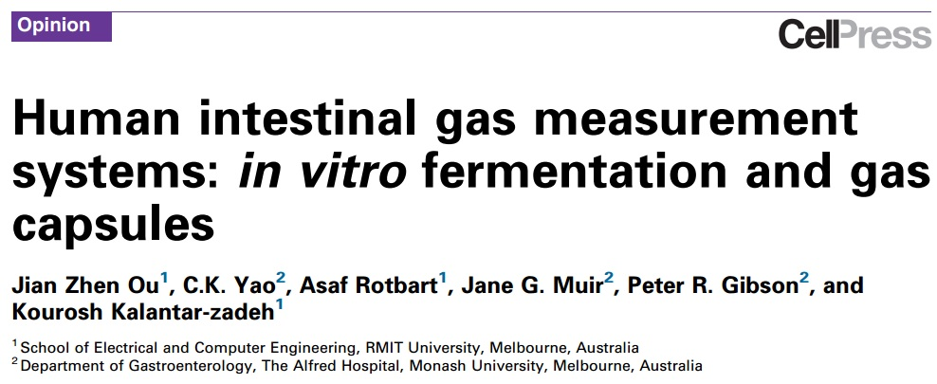
Example 2:
In 2014, I needed to prepare a review paper to position a developed idea/prototype called “human gas capsule“ in the clinical diagnostic field.
Time from preparation to submission: 3 months

Slide 19

Example 2 (difficulties):
I don’t have any knowledge in the field (gastroenterology, physiology, clinical science etc.)
I don’t know what are the current approaches to measure the gas in the human gastrointestinal tract
I am a healthy person free from gut diseases and disorders
Ref: ashleyjamespryce.wordpress.com

Slide 20
Example 2 (questions in my mind):
How does the intestinal gas produced?
What is the link between intestinal gas and gut diseases and disorders?
What are the techniques to measure the intestinal gas?
What are the instrumentation involved?

Slide 21
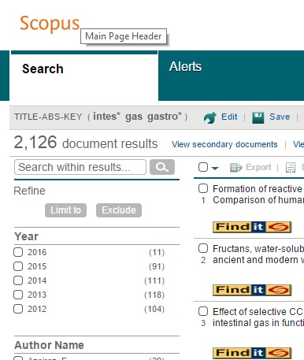
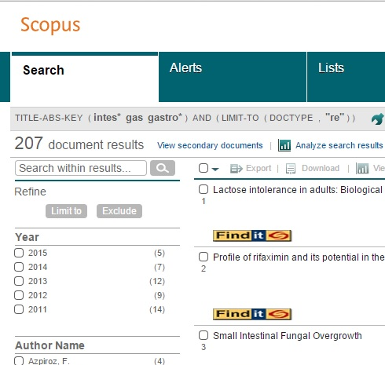
Example 2 (finding the structure):
Keywords: gastrointestinal gas (intestine* gas gastro*)
By searching only the current review articles, the number of literature required to read is greatly reduced (from 2126 to 207).

Slide 22
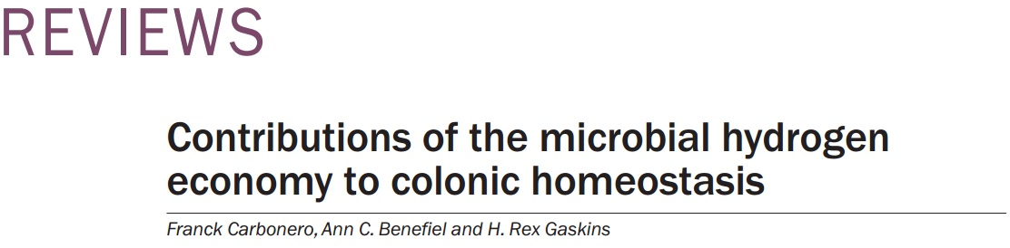
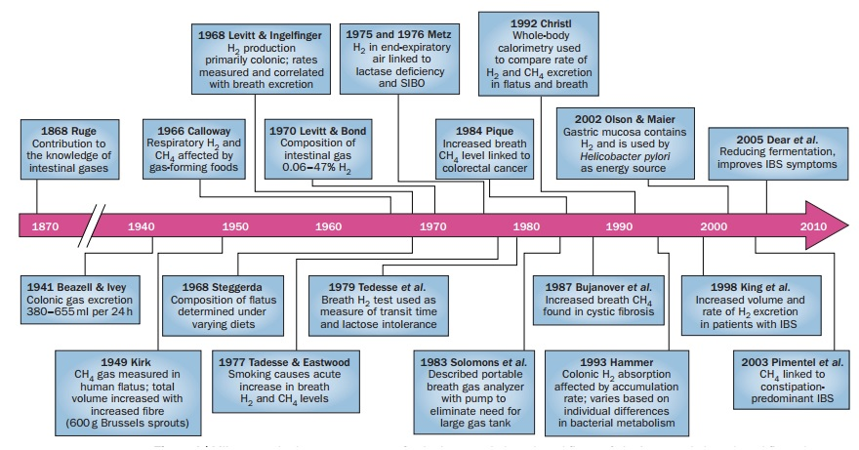
Example 2:

Slide 23
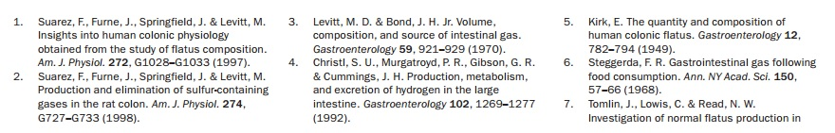
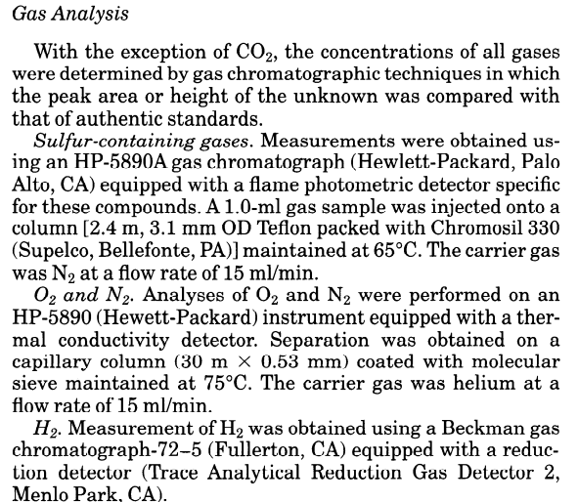
Example 2:
Look at the cited references can be a quick way to get the updated information.
Help to construct the knowledge framework.

Slide 24
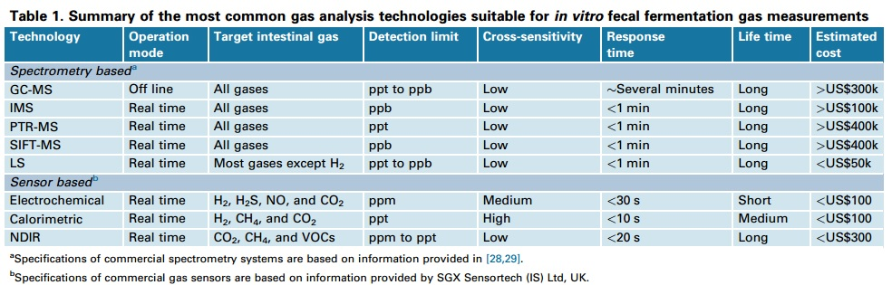
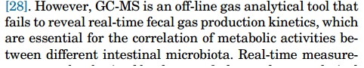
Example 2:
Again, use the table to summarise the findings.
Critical analysis is presented but may not be comprehensive.

Slide 25
Example 2 (Revised structure):
How does the intestinal gas produced?
What is the link between intestinal gas and gut diseases and disorders?
What are the techniques to measure the intestinal gas?
What are the instrumentation involved?
Intestinal gases as biomarkers
Microbial contribution to the intestinal gas
Links between intestinal gas and gut diseases and disorder
Breath analysis (clinical significance and instrumentation)
In vitro faecal fermentation system (clinical significance and instrumentation)
In vivo human gas capsule (position in the diagnostics)

Slide 26
Suggested structure for a mini-literature review
Assuming the word limit is ~1000, literature reviewing a technique
Introduction (200-300 words)
- brief description of this technique, history? Market capacity? Significance?
Summary of different approaches for realizing this technique (400-500 words)
- review structure applied
Critical discussion (100-200 words)
Applications and conclusion (100-200 words)

Slide 27
Conclusions
Literature review is a learning process.
The time you spent on literature review is proportional to how comprehensive the review is.
The depth of the critical discussion in the literature review depends on how well you understand the field.
A good structure is the key of success in literature review.
No shortcut!

